Slide 1
Ch08 Functions and Functional Programming
Highlights of the chapter:
8.1 Overview of functions
8.2 Function declarations and calls
8.3 Passing of parameters
8.4 Return Values of Functions
8.5 Scope of variables
8.6 Recursive Functions
8.7 Use of Built-in Functions
8.8 Python Functional Programming Basics
8.9 Integrated application: turtle module to draw complex shapes

Slide 2
Function Overview
Basic Concepts of Functions
Functions are used to separate different tasks in a program
Functions allow program control to switch between calling code and function code
Functions of the function
(1) Realization of structured program design. Top-down structured design can be achieved by partitioning the program into different functional modules
(2) Reduce the complexity of the program. Simplify the structure of the program and improve the readability of the program
(3) Realize code reuse. Define once and call many times to realize the reusability of the code
(4) Improve the quality of code. The code that realizes the sub-tasks after segmentation is relatively simple and easy to develop, debug, modify and maintain
(5) Collaborative development. After a large-scale project is divided into different sub-tasks, the team can divide the work and work together at the same time to collaborate on development
(6) Realization of special functions. Recursive functions can realize many complex algorithms

Slide 3
Classification of Python Functions
(1) Built-in functions: Python has built-in several commonly used functions, such as abs(), len(), etc., which can be used directly in the program.
(2) Standard Library Functions: The Python language installer installs several standard libraries, such as math, random, and so on. You can import the libraries and use the functions defined in them by using the import statement.
(3) Third-party library functions.The Python community provides many other high-quality libraries, such as the Python Image Library and so on. After downloading and installing these libraries, you can import them and use the functions defined in them by using the import statement
(4) User-defined functions. This chapter will discuss in detail the definition of the function and the method of invocation

Slide 4

Function declaration and invocation (1)
[Example 8.1] Function Creation Example 1: Define a function that returns the average of two numbers.
[Example 8.2] Function Creation Example 2: Defining a Function that Prints n Asterisks with No Return Value
def my_average(a, b).
return (a+b)/2
def print_star(n):
print((("*"*n).center(50)) #Print n asterisks, padded with spaces on both sides, total width 50

Slide 5
Function declaration and invocation (2)
[Example 8.3] Function Creation Example 3: Define a function that calculates and returns the nth-order summation number (1 + 1/2 + 1/3 + ... + 1/n).
def harmonic(n): #Calculate the harmonic number of order n (1 + 1/2 + 1/3 + ... + 1/n)
total = 0.0
for i in range(1, n+1):
total += 1.0 / i
return total

Slide 6

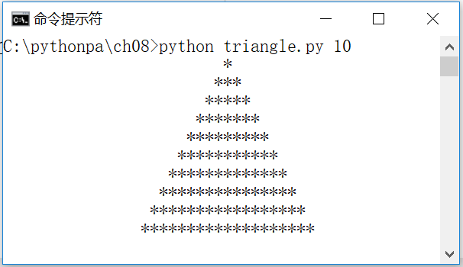
Calls to functions (1)
[Example 8.4] Example of a function call 1 (triangle.py): first define a function print_star(n) that prints n asterisks with no return value, then get the number of lines lines of triangles to be printed from the first parameter on the command line lines lines, and loop through the call to the print_star() function to output isosceles triangles made up of asterisks, with each line printing 1 , 3, 5, ... 2*lines-1 asterisks
import sys
def print_star(n):
print((("*"*n).center(50)) #Print n asterisks, padded with spaces on both sides, total width 50
lines = int(sys.argv[1]) #Triangle lines
for i in range(1, 2*lines,2): #Print 1, 3, 5, ... , 2*lines-1 asterisks
print_star(i)

Slide 7
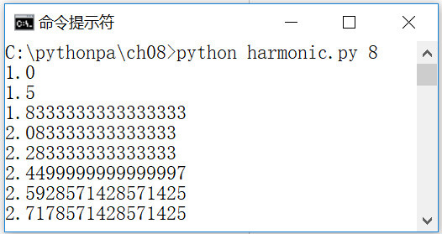
[Example 8.5] Function Call Example 2
Calls to functions (2)
First a function that defines a function that calculates and returns the nth harmonic number (1 + 1/2 + 1/3 + ... + 1/n), outputting the first n harmonic numbers
import sys
def harmonic(n): #Calculate the harmonic number of order n (1 + 1/2 + 1/3 + ... + 1/n)
total = 0.0
for i in range(1, n+1):
total += 1.0 / i
return total
n = int(sys.argv[1]) # get the harmonic number order from the first argument on the command line
for i in range(1, n+1): #Output the value of the first n summed numbers
print(harmonic(i))

Slide 8
Side effects of functions
pure function
Takes one or more arguments and, by calculation, returns a value
Side effects of functions
Reading keyboard input, generating output, changing the state of the system, etc.
The side effect of the function print_star(n) is to write a number of asterisks to the standard output

Slide 9
Lamda Expressions and Anonymous Functions
A lambda is an easy way to define a function on the same line. lambda actually generates a function object, i.e., an anonymous function
The basic format of a Lamda expression is
[Example 8.6] Anonymous Function Example 1
>>> f = lambda x,y: x + y
>>> type(f) #Output: <class 'function'>
<class 'function'>
>>> f(12, 34) # Calculate the sum of the two numbers. Output: 46
46

Slide 10
Anonymous Function Example 2
[Example 8.7] Application of Anonymous Function 2
# Default sorting by the first element of the tuple
>>> sorted([('Bob',75),('Adam',92),('Lisa',88)])
[('Adam', 92), ('Bob', 75), ('Lisa', 88)]
# Sort by the second element of the tuple
>>> sorted([('Bob',75),('Adam',92),('Lisa',88)],key=lambda t:t[1])
[('Bob', 75), ('Lisa', 88), ('Adam', 92)]

Slide 11
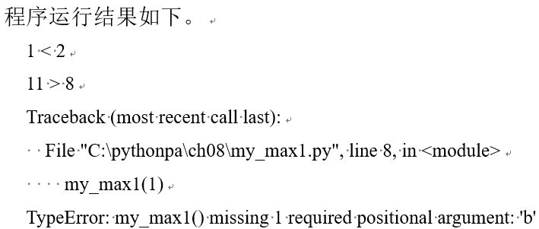
Passing of parameters
Formal and actual parameters
The parameters declared when declaring a function are formal parameters, or formal parameters for short.
When you call a function, you provide the values of the parameters required by the function, i.e., the actual parameters, referred to as real parameters
[Example 8.8] Examples of formal and real parameters (my_max1.py)
def my_max1(a, b).
if a > b: print(a, '>', b)
elif a == b: print(a, '=', b)
else: print(a, '<', b)
my_max1(1, 2)
x = 11; y = 8
my_max1(x, y)
my_max1(1)

Slide 12
Formal parameter variables and object reference passing
Formal parameters declared when declaring a function are equivalent to local variables in the body of the function and can be used anywhere in the function body
The difference between local variables and formal parameter variables is that local variables are bound to an object in the body of the function, while formal parameter variables are bound to the object of the actual parameter passed in the function call code.
Python parameter passing methods pass object references, not object values

Slide 13
Passing references to immutable objects(1)
i=100
def inc(j,n).
j += n
inc(i,10)
print(i)
If the value of an object is modified in the function body, the result is actually the creation of a new object
[Example 8.9] Example of passing a reference to an immutable object (inc1.py): wrong increment function
The initial value of i is 100, when the function inc(i,10) is called, in the body of the function, the statement "i+=10" is executed, and the value of i in the body of the function becomes 110. However, when the function is called and returned to the main program, the value of i is still 100 because the integer i is an immutable object, and in the Python language, a function cannot change the value of an immutable object (e.g., integer, float, boolean, or string). In Python, a function cannot change the value of an immutable object (e.g., an integer, a float, a boolean, or a string). value of an immutable object (i.e., a function cannot have side effects).

Slide 14
Passing references to immutable objects(2)
[Example 8.10] Example of passing a reference to an immutable object (inc2.py): the correct increment function
i=100
def inc(j,n).
j += n
return j
i =inc(i,10)
print(i)
In this example, the initial value of i is 100, when the expression i = inc(i,10) "call function inc(i,10), in the function body, the execution of the" i += 10 "statement, in the function body of the i became 110, and the function returns 110. when the function is called back to the main program. function is called to return to the main program, i is assigned the value of 110.

Slide 15
Passing references to mutable objects(1)
If you pass a reference to a mutable object (e.g., a list object) when you call a function, you can modify the value of the object directly in the body of the function.
Example 8.11: Functions Passing Variable Object References Example 1: Define a function that exchanges the values of two specified subscripts in a given list.
def exchange(a, i, j).
temp = a[i]
a[i] = a[j]
a[j] = temp

Slide 16
Passing references to mutable objects(2)
[Example 8.12]: Example 2 of a function that passes variable object references: Randomly mixing the values of elements in a given list
def shuffle(a).
n = len(a) #Get the length of list a n
for i in range(n): #0~n-1 for loop iteration
r = random.randrange(i, n) # take a random integer between [i,n)
exchange(a, i, r) #Exchange the values of the elements of list a whose subscripts are i and r, respectively.

Slide 17

Optional parameters
When declaring a function, if you want some of the function's arguments to be optional, you can specify default values for those arguments when declaring the function
When this function is called, if no corresponding real parameter value is passed, the function uses the default parameter value specified at the time of declaration
[Example 8.13] Example of optional parameter (my_sum1.py): Calculate the overall evaluation grade based on the midterm and final grades according to the specified weighting
def my_sum1(mid_score, end_score, mid_rate = 0.4): # Midterm grade, final grade, midterm grade weights
# Calculate an overall grade based on midterm grades, final grades and weights
score = mid_score * mid_rate + end_score * (1 - mid_rate)
print(format(score, '.2f')) #Output the overall evaluation score, retaining 2 decimals
my_sum1(88, 79) #Midterm grades are weighted at the default 40%
my_sum1(88, 79, 0.5) #Midterm grade weighting set to 50%

Slide 18
Positional and Named Parameters
When a function is called, real parameters are passed in positional order by default for formal parameters. Parameters passed in positional order are called positional parameters
Function calls can also specify incoming parameters by name (keyword), e.g. my_max1(a=1, b=2); my_max1(b=2, a=1)
Specifying incoming parameters by name is called a named parameter, also known as a keyword parameter. The use of keyword parameters has three advantages: the parameter is explicit by name; the parameters are passed in an order-independent manner; and if there are more than one optional parameter, you can choose to specify a particular parameter value
Parameters declared after an asterisked parameter are forced to be named parameters, and if these parameters do not have a default value and must be assigned a value using a named parameter when called, an error is raised
If you don't need an asterisked parameter, but just need to force the naming of the parameter, you can simply use an asterisk, e.g. def total(initial=5, *, vegetables)

Slide 19
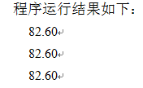
[Example 8.14] Example of Named Parameters
[Example 8.14] Named Parameter Example (my_sum2.py): Calculate an overall grade based on midterm and final grades with the specified weighting
def my_sum2(mid_score, end_score, mid_rate = 0.4): # Midterm grade, final grade, midterm grade weights
# Calculate an overall grade based on midterm grades, final grades and weights
score = mid_score * mid_rate + end_score * (1 - mid_rate)
print(format(score, '.2f')) #Output the overall evaluation score, retaining 2 decimals
# Midterm 88, final 79, and midterm grades are weighted at the default 40%. The three calls are equivalent
my_sum2(88, 79)
my_sum2(mid_score = 88, end_score = 79)
my_sum2(end_score = 79, mid_score = 88)

Slide 20
Variable Arguments (VarArgs) (1)
When declaring a function, a variable number of real parameters are allowed to be passed to the function via starred arguments such as *param1. When the function is called, all arguments from that point onward are collected into a tuple
When declaring a function, it is also possible to pass a variable number of real parameters to the function by means of a parameter with a double star, e.g. **param2, allowing a variable number of real parameters to be passed to the function. When the function is called, all arguments from that point onwards are collected into a dictionary
Parameters with a star or double star must be at the end of the list of formal parameters.

Slide 21
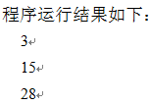
Variable Arguments (VarArgs) (2)
[Example 8.15] Variable Parameter Example 1 (my_sumVarArgs1.py). Calculate the sum of each digit cumulative sum using the parameter with the star
def my_sum3(a, b, *c): #Accumulate the sums of the numbers
total = a + b
for n in c:
total = total + n
return total
print(my_sum3(1, 2)) #calculate 1+2
print(my_sum3(1, 2, 3, 4, 5)) #Calculate 1+2+3+4+5
print(my_sum3(1, 2, 3, 4, 5, 6, 7)) #Calculate 1+2+3+4+5+6+7

Slide 22
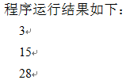
Variable Arguments (VarArgs) (3)
[Example 8.16] Variable Parameters Example 2 (my_sumVarArgs2.py). Calculate the sum of each digit cumulative using the parameters with stars and double stars
def my_sum4(a, b, *c, **d): #Accumulate the sums of the numbers
total = a + b
for n in c: # sum the elements in the tuple
total = total + n
for key in d: # sum the elements of the dictionary
total = total + d[key]
return total
print(my_sum4(1, 2)) #calculate 1+2
print(my_sum4(1, 2, 3, 4, 5)) #Calculate 1+2+3+4+5
print(my_sum4(1, 2, 3, 4, 5, male = 6, female = 7)) #Calculate 1+2+3+4+5+6+7

Slide 23
Mandatory named parameters (Keyword-only) (1)
Asserting a parameter after an asterisked parameter results in the forced naming of the parameter (Keyword-only)
Calls must be explicitly passed values using named parameters, as parameters passed by position are collected as a tuple by default, passed to variable parameters preceded by an asterisk
If you don't need variable arguments with stars and just want to use forced named arguments, you can simply use an asterisk. For example: def my_func( *, a, b, c)

Slide 24
Mandatory named parameters (Keyword-only) (2)
[Example 8.19] Example of forced named parameters (keyword_only.py). Calculate an overall grade based on midterm and final grades with specified weights
def my_sum(*, mid_score, end_score, mid_rate = 0.4): # Midterm grade, final grade, midterm grade weights
# Calculate an overall grade based on midterm grades, final grades and weights
score = mid_score * mid_rate + end_score * (1 - mid_rate)
print(format(score, '.2f')) #Output the overall evaluation score, retaining 2 decimals
my_sum(mid_score = 88, end_score = 79) # 88 at midterm, 79 at end of period, midterm weights are defaulted to 40%
my_sum(end_score = 79, mid_score = 88) #end_score = 79, mid_score = 88, mid_score weights are 40% by default
my_sum(88, 79) #Error reported, must pass value explicitly using named parameters

Slide 25
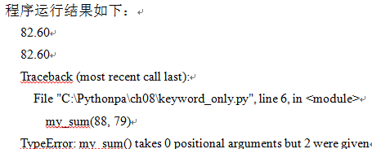
Mandatory named parameters (Keyword-only) (2)
[Example 8.19] Example of forced named parameters (keyword_only.py). Calculate an overall grade based on midterm and final grades with specified weights

Slide 26
Parameter type checking
Define functions without qualifying the types of their arguments and return values
This flexibility allows for polymorphism, i.e., it allows functions to be applied to different types of objects, e.g., the my_average(a,b) function, i.e., it can return the average of two int objects, or it can return the average of two float objects
Errors are thrown when functions are called with arguments of unsupported types. For example, when the my_average(a,b) function is passed a str object as an argument, Python will throw the error TypeError at runtime
The user must understand and ensure that the correct type of parameter value is passed when calling the function

Slide 27

Parameter type checking and type annotations
In Python 3.5 onwards, it is possible to annotate the types of formal parameters and return values of functions. You can also annotate the types of variable identifiers.
[Example 8.20] Type annotation example (type_annotation.py).
def area(r: float) -> float: #Use formal parameter: type annotation for formal parameter type, use -> type annotation for return value type
res: float = 3.14 * r * r #use variable name: type annotation variable type
return res
r1 = 1.2 # the radius of the circle is 1.2
print(area(r1)) #call the function that calculates and outputs the area of the circle
Note: Type annotations are merely declarations of types, not mandatory restrictions. However, some development tools (e.g. Pycharm) will do type inference based on this specified type

Slide 28
The return value of a function
return statements and function return values
[Example 8.21] Example of the return value of a function (my_max.py). Write a function that returns the value of a function using a return statement to find the maximum value of a number of numbers
The general method for finding the maximum value of a number of numbers is as follows:
(1) Set the initial value of the maximum value to a smaller number, or take the first number as the initial value of the maximum value.
(2) Using a loop, compare each number to the maximum value, and if this number is greater than the maximum value, set this number to the maximum value
def my_max(a, b, *c): #Find the maximum of several numbers.
max_value = a #assume the first number is the maximum value
if max_value < b: # If max_value is less than b, then b is the maximum value
max_value = b
for n in c: # loop iterates over each element n in c, if the maximum value is less than n, then n is the maximum value
if max_value < n.
max_value = n
return max_value #Use the return statement to return the maximum value.
# Test code
print(my_max(1, 2)) #find the maximum of (1, 2)
print(my_max(1, 7, 11, 2, 5)) #find the maximum of (1, 7, 11, 2, 5)

Slide 29

The return value of a function
return statements and function return values
[Example 8.21] Example of the return value of a function (my_max.py). Write a function that returns the value of a function using a return statement to find the maximum value of a number of numbers
def my_max(a, b, *c): #Find the maximum of several numbers.
max_value = a #assume the first number is the maximum value
if max_value < b: # If max_value is less than b, then b is the maximum value
max_value = b
for n in c: # loop iterates over each element n in c, if the maximum value is less than n, then n is the maximum value
if max_value < n.
max_value = n
return max_value #Use the return statement to return the maximum value.
# Test code
print(my_max(1, 2)) #find the maximum of (1, 2)
print(my_max(1, 7, 11, 2, 5)) #find the maximum of (1, 7, 11, 2, 5)

Slide 30
Multiple return statements
The return statement can be placed anywhere in the function, and when the first return statement is executed, the program returns to the calling program.
[Example 8.22] Determining Prime Numbers (prime.py). Prepare a function that determines whether a number is prime, and then write test code that determines and outputs the number of prime numbers in the range of 1~99.
def is_prime(n):
if n < 2: return False #If n is less than 2, return False
i = 2
while i*i <= n.
# Once n is divisible by any integer from 2~, n is not prime, return False.
if n % i == 0: return False
i += 1
return True
# Test code
for i in range(100): # Determine and output the number of prime numbers from 1 to 99, separated by spaces.
if is_prime(i):print(i, end=' ')

Slide 31
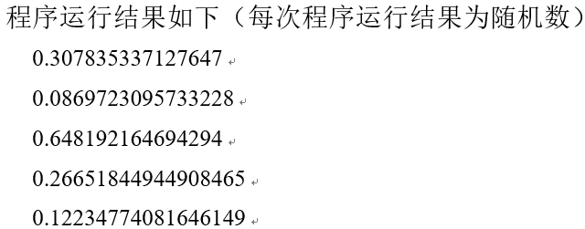
Return multiple values
Using a return statement in the body of a function enables you to return a value from the function and jump out of the function. If you need to return more than one value, you can return a tuple
[Example 8.23] Write a function that returns a randomized list. Random List (randomarray.py). First, write a function that generates a list of n random integers, and then write test code that generates and outputs the values of each element of a list of 5 random integers
import random
def randomarray(n): #Generate a list of n random numbers
a = []
for i in range(n):
a.append(random.random())
return a
# Test code
b=randomarray(5) #generate a list of 5 random numbers
for i in b: print(i) #Output each element of the list

Slide 32
Scope of variables (1)
Global Variables, Local Variables, and Type Member Variables
Global variables: variables declared outside of function and class definitions in a source code file
Global variables are scoped to the module in which they are defined, from the point where they are defined until the end of the file.
Modules can be imported with the import statement, or accessed with the fully qualified name "module name. Variable Name". Alternatively, you can import the variables in the module and access them via the from...import statement.
[Example 8.24] Global Variable Definition Example (global_variable.py)
TAX1 = 0.17 # Tax constant 17%
TAX2 = 0.2 #Tax constant 20%
TAX3 = 0.05 # tax constant 5%
PI = 3.14 #Perimeter 3.14

Slide 33
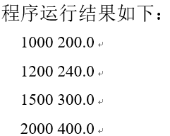
[Example 8.25]: Example of using global variables
Scope of variables (2)
import global_variable #Import global variable definitions
def tax(x): #Calculate the tax value based on a tax constant of 20%
return x * global_variable.TAX2
# Test code
a = [1000, 1200, 1500, 2000]
for i in a: #Calculate and print the tax value of the 4 data entries
print(i, tax(i))

Slide 34
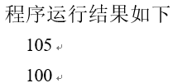
local variable
Variables declared in the body of a function (including function parameters) are called local variables, and their valid scope (scope) is the function body.
If a local variable (or formal parameter variable) defined in a function is renamed with a global variable, the local variable (or formal parameter variable) takes precedence, i.e., the variable defined in the function refers to the local variable (or formal parameter variable), not the global variable
[Example 8.26] Local Variable Definition Example
num = 100 # global variable
def f().
num = 105 #local variable
print(num) # Output the value of the local variable
# Test code
f();print(num)

Slide 35
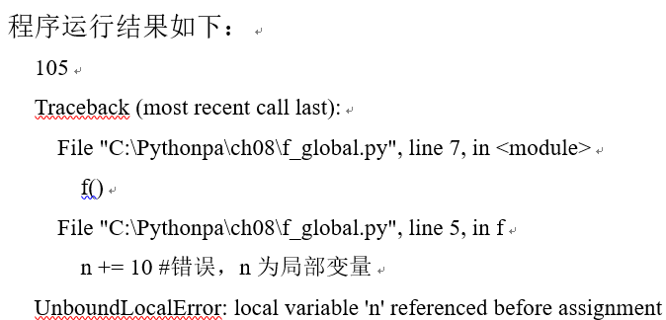
Global statement global (1)
Global variables can be referenced in the body of a function, but if the name of the variable inside the function is the first occurrence and before the assignment statement (variable assignment), it is interpreted as defining a local variable
[Example 8.27] Example of a function body misreferencing a global variable
m = 100
n = 200
def f().
print(m+5) #Reference the global variable m
n += 10 # Error, n precedes assignment statement, interpreted as local variable (not present)
# Test code
f()

Slide 36
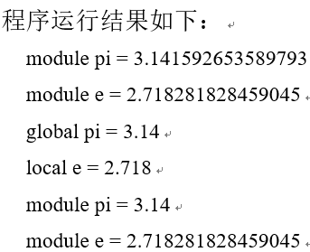
Example 8.28: Example of global statement global
Global statement global (2)
pi = 3.141592653589793 #global variable
e = 2.718281828459045 #global variable
def my_func().
global pi # global variable, pointing to the same object as the previous global variable pi
pi = 3.14 # changed the value of the global variable
print('global pi =', pi) # output the value of the global variable
e = 2.718 # local variable pointing to a different object than the previous global variable e
print('local e =', e) # output the value of the local variable
# Test code
print('module pi =', pi) # output the value of the global variable
print('module e =', e) # Output the value of the global variable
my_func() #call the function
print('module pi =', pi) # Output the value of the global variable, which has been changed in the function
print('module e =', e) # Output the value of the global variable

Slide 37
Non-local statements nonlocal
Within a function body, nested functions can be defined, and within a nested function, if you want to assign a value to a local variable defined in the parent function body, you can use the nonlocal statement to indicate that the variable is not local to the block in which it is located, but is local to a variable defined in the parent function body. nonlocal statements can specify more than one nonlocal variable. For example, nonlocal x, y, z
[Example 8.29] Example of the nonlocal statement nonlocal

Slide 38
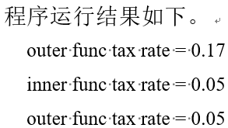
Non-local statements nonlocal
[Example 8.29] Example of the nonlocal statement nonlocal
def outer_func().
tax_rate = 0.17 # local variable in parent function body
print('outer func tax rate =', tax_rate) # Output the value of the local variable in the body of the parent function
def innner_func().
nonlocal tax_rate # Not a local variable in the block, but a local variable defined in the body of the parent function.
tax_rate = 0.05 # Reassign local variables in parent function body
print('inner func tax rate =', tax_rate) # Output the value of the local variable in the parent function body
innner_func() #call function
print('outer func tax rate =', tax_rate) # Output the value of the local variable in the body of the parent function (changed)
# Test code
outer_func()

Slide 39
class variable
Class member variables are variables declared in a class, including static and instance variables, whose valid scope is within the class definition.
Externally, you can access the instance variables of a class by creating an object instance of the class and then accessing the instance variables of the class via "Object. Instance Variables" to access instance variables of the class, or "Class. Static Variables" to access static variables of the class.

Slide 40
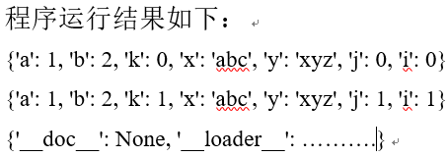
Exporting local and global variables (locals and globals functions)
Using the built-in functions globals() and locals(), you can view and output a list of local and global variables
[Example 8.30] Example list of local and global variables (locals_globals.py)
a=1
b=2
def f(a, b).
x = 'abc'
y = 'xyz'
for i in range(2): #i=0~1
j = i
k = i**2
print(locals())
# Test code
f(1,2)
print(globals())

Slide 41

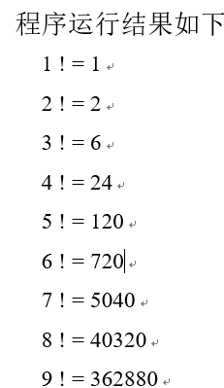
recursive function
A self-calling function that calls itself, directly or indirectly, from within the body of the function, i.e., a nested call to the function is the function itself
[Example 8.31] Using Recursive Functions to
Implement Factorials
def factorial(n).
if n == 1: return 1
return n * factorial(n - 1)
# Test code
for i in range(1,10): #Output the factorial of 1~9
print(i,'! =', factorial(i))

Slide 42
Principles of recursive functions (1)
Each recursive function must include the following two main parts.
(1) Termination condition. Indicates the end of the recursive conditions, used to return to the function value, no longer recursive call. For example, factorial () function for the end of the condition "n is equal to 1".
(2) Recursive step. The recursive step associates the function with the value of the argument at step n with the function with the value of the argument at step n-1. For example, for factorial(), the recursive step is "n * factorial(n-1)"
For example, the formula for the harmonic number is:
H_{n} = 1 + 1/2 + . . . + 1/n
Therefore, it can be realized using recursive functions:
（1）终止条件：H_{n} = 1 #当n==1时
（2）递归步骤：H_{n} = H_{n-1} + 1/n #当n>1时
With each recursion, n is strictly decreasing, so it gradually converges to 1.

Slide 43
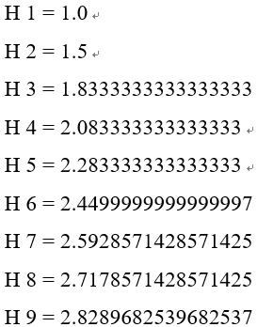
[Example 8.32] Using Recursive Functions to Implement Reconciliation Numbers
Principles of recursive functions (2)
def harmonic(n).
if n == 1: return 1.0 #termination condition
return harmonic(n-1) + 1.0/n #recursive step
# Test code
for i in range(1,10): #Output the summed number of orders 1~9
print('H', i, ' =', harmonic(i))

Slide 44
Issues to be aware of with recursive functions
(1) Termination conditions must be set
A recursive function that lacks a termination condition will result in an infinite number of recursive function calls, with the end result that the system will run out of memory.
(2) Convergence must be guaranteed
Otherwise, it will also lead to infinite recursive function calls
(3) It must be ensured that memory and arithmetic consumption are kept under control

Slide 45

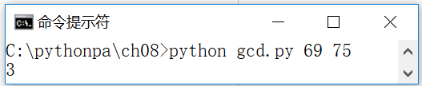
Applications of recursive functions: greatest common divisor
[Example 8.33] Calculating the greatest common divisor using a recursive function (gcdRecursion.py)
import sys
def gcd(p, q): #Calculate the greatest common divisor of p and q using the recursive function
if q == 0: return p #If q=0, return p
return gcd(q, p % q) #Otherwise, recursively call gcd(q, p % q)
# Test code
p = int(sys.argv[1]) #p=first argument on command line
q = int(sys.argv[2]) #q = second argument on command line
print(gcd(p, q)) #Calculate and output the greatest common divisor of p and q

Slide 46
Applications of Recursive Functions: Hannover Tower
When Maharaja created the world, he made three adamantine pillars in the sacred temple at Benares, the center of the world, and on one pillar 64 golden discs were stacked in order of size from bottom to top. It is called the Tower of Hannukah.
The Maharishi ordered the Brahmins to rearrange the disks from one pillar to another in order of size. And it was stipulated that only one disk could be moved at a time between the three pillars and that no large disk could be placed on top of a small disk. This game is called Hannukah Tower Puzzle Game
The problem of the Hanoi Tower puzzle game is easily realized using recursive functions. Assuming that the columns are numbered a, b, and c, and defining the function hanoi(n, a, b, c) to mean move n disks from column a to column c (which can be done via column b).

Slide 47
Applications of Recursive Functions: Hannover Tower
The problem of the Hanoi Tower puzzle game is easily realized using recursive functions. Assuming that the columns are numbered a, b, and c, and defining the function hanoi(n, a, b, c) to mean move n disks from column a to column c (which can be done via column b), there are:
(1) Termination conditions. When n==1, hanoi(n, a, b, c) is the termination condition. That is, if there is only one disk on column a, it can be moved directly to column c
(2) Recursive steps. hanoi(n, a, b, c) can be decomposed into three steps: hanoi(n-1,a,c,b), hanoi(1,a,b,c) and hanoi(n-1,b,a,c). If there are n discs on column a, it can be viewed as one disc (chassis) and (n-1) discs on column a. Firstly, we need to move the (n-1) discs on top of column a to column b, i.e., call hanoi(n-1,a,c,b); then, we need to move the last disc on column a to column c, i.e., call hanoi(1,a,b,c); and then, move the column b to column c, i.e., call hanoi(n-1,b,a,c); then move the (n-1)th disk on column b to column c, i.e., call hanoi(1,a,b,c)
With each recursion, n is strictly decreasing, so it gradually converges to 1

Slide 48
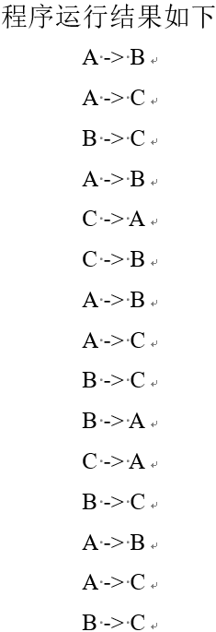
[Example 8.34] Using Recursive Functions to Realize the Hannover Tower Problem (hanoi.py)
# Move n disks arranged in order from smallest to largest from column a to column c, with column b serving as an intermediate buffer
def hanoi(n,a,b,c).
if n==1: print(a,'->',c) # there is only one disk, move the disk directly from column a to column c
else.
hanoi(n-1,a,c,b) # first move n-1 disks from column a to column b (using recursion)
hanoi(1,a,b,c) # then move the largest disk from column a to column c
hanoi(n-1,b,a,c) #move n-1 more disks from column b to column c (using recursion)
# Test code
hanoi(4,'A','B','C')

Slide 49
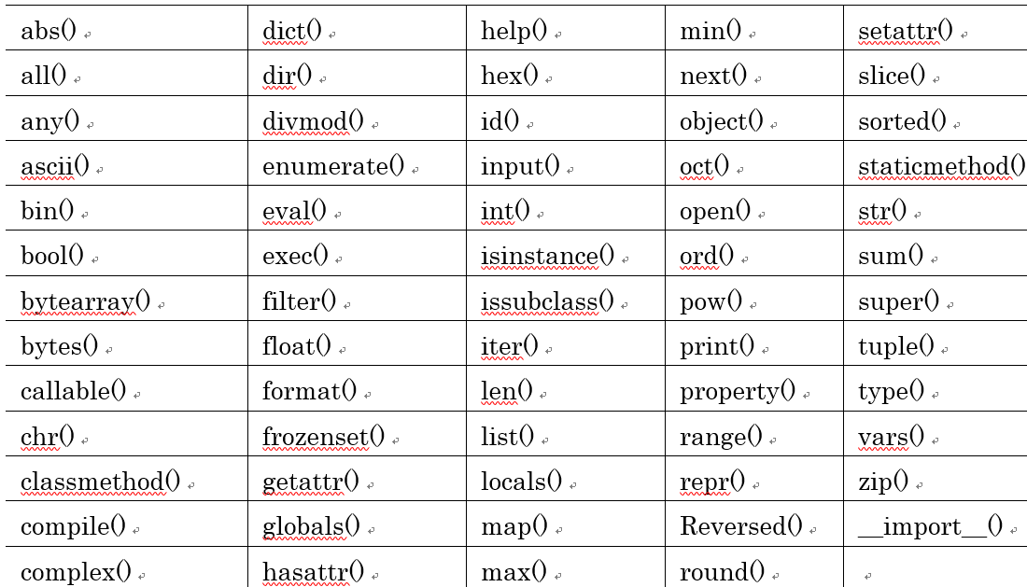
Use of built-in functions

Slide 50

eval function (evaluation of dynamic expressions)
expression is the string of the dynamic expression; globals and locals are the global and local variables of the context to be used when evaluating the value; if not specified, the current runtime context is used.
>>> x=2
>>> str_func = input("Please enter an expression: ")
Please enter the expression: x**2 + 2*x + 1
>>> eval(str_func) #Evaluate the expression 2**2+2*2+1. Output: 9
9

Slide 51

exec function (execution of dynamic statements)
str is the string for the dynamic statement; globals and locals are global and local variables for the context used; if not specified, the current runtime context is used
>>> exec("for i in range(10): print(i, end=' ')") #Output: 0 1 2 3 4 5 6 7 8 9
0 1 2 3 4 5 6 7 8 9
Typically, eval is used for dynamic expression evaluation and returns a value; exec is used for dynamic statement execution and does not return a value.

Slide 52
The compile function (execution of dynamic statements)
source is the string of the code statement; if it is a multiline statement, there must be a newline character \n at the end of each line. filename is the file containing the code. mode is the compilation mode, which can be: 'exec' (for a series of statements to be executed), 'eval' (for an expression to be evaluated), and 'single' (for a single interactive statement).
>>> co = compile("for i in range(10): print(i, end=' ')", '', 'exec')
>>> exec(co) #Output: 0 1 2 3 4 5 6 7 8 9
0 1 2 3 4 5 6 7 8 9

Slide 53
Python Functional Programming Basics
Functions as Objects
[Example 8.35] Example of a function as an object.
>>> f=abs
>>> type(f) #Output: <class 'builtin_function_or_method'>
>>> f(-123) # Return the absolute value. Output: 123
(math.) higher order function
Functions whose arguments are function objects or functions that return function objects are called higher-order functions, i.e. functions of functions
[Example 8.36] Example of a higher-order function.
>>> def compute(f, s): #f is a function object, s is a series object
return f(s)
>>> compute(min, (1, 5, 3, 2)) # Return the minimum value of the sequence. Output: 1
>>> compute(max, (1, 5, 3, 2)) # Return the maximum value of the sequence. Output: 5

Slide 54
Built-in map() function (1)
The map() function is implemented as a built-in map(f, iterable, ...) iterable object, apply the function f to the iterable object, return the result as an iterable object
[Example 8.37] map () function example 1: customize the function is_odd, apply the function to each element of the iterable object, return whether it is an odd number of iterable object results
[Example 8.38] map() function example 2: using the built-in function abs, return a list of absolute values
>>> def is_odd(x).
return x % 2 == 1
>>> list(map(is_odd, range(5))) #Output: [False, True, False, True, False]
[False, True, False, True, False]
>>> list(map(abs, [1,-3, 5, 6, -2, 4])) #output: [1, 3, 5, 6, 2, 4]
[1, 3, 5, 6, 2, 4]

Slide 55
Built-in map() function (2)
[Example 8.39] map() function example 3: use the built-in function str to return a string representation of the element
[Example 8.40] map() function example 4: the use of custom functions with two parameters, the realization of the elements of the two lists in order to compare the results of the arithmetic operations
>>> list(map(str, [1,2,3,4,5])) #Output: ['1', '2', '3', '4', '5']
['1', '2', '3', '4', '5']
>>> def greater(x, y).
return x > y
>>> list(map(greater,[1,5,7,3,9],[2,8,4,6,0]))
[False, False, True, False, True]

Slide 56
Built-in filter() function
The filter() function is implemented as the built-in filter(f, iterable) iterable object (see Chapter 9), which applies the function f to each element and then decides whether to keep or discard the element based on whether the return value is True or False, returning the result as an iterable object
[Example 8.42] filter() function example 1: return an odd number of iterable objects
>>> def is_odd(x).
return x % 2 == 1
>>> list(filter(is_odd, range(10))) #output: [1, 3, 5, 7, 9]

Slide 57
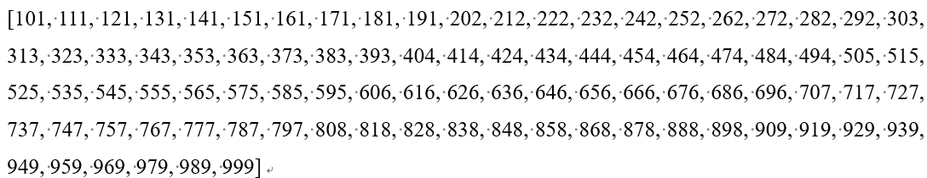
Built-in filter() function
[Example 8.43] filter() function example 2: return the number of three-digit palindromes (positive and negative order are the same) iterable objects
>>> def is_palindrome(x).
if str(x) == str(x)[::-1]:.
return x
>>> list(filter(is_palindrome, range(100,1000)))

Slide 58
Operator Modules and Operator Functions
The operator module is a function interface to Python's built-in operators, which defines functions that correspond to operations such as arithmetic and comparison. It can be used for map(), filter(), and other occasions where you need to pass a function object as a parameter, and can be used directly without the need to use function definitions or lambda expressions, making the code more concise.
[Example 8.47] Viewing Function Objects in the Operator Module
>>> import operator
>>> dir(operator)
[Example 8.48] Operator Module Application Example 1: Using functions in the operator module instead of operators, concat(s1, s2) corresponds to s1+s2
>>> import operator
>>> a = 'hello'
>>> operator.concat(a, 'world') #Output: 'hello world'
[Example 8.49] Using the operator.gt function object (corresponding to the operator >) in map() to realize the operation of comparing the elements of two lists.
>>> import operator
>>> list(map(operator.gt,[1,5,7,3,9],[2,8,4,6,0]))
[False, False, True, False, True]

Slide 59
functools.reduce function
reduce() function is implemented as functools.reduce(f, iterable[, initializer]) function, using the specified function f with two parameters, all the data of a collection of data (iterable object) to carry out the following operations: use the first and the second data as parameters to operate with the func function, and get the result again with the third data as a parameter with the func () function, and so on, and finally get a result. f is function object; iterable is an iterable object; optional initializer is an initial value
[Example 8.50] functools.reduce() Example 1: Calculate the cumulative sum.
>>> import functools, operator
>>> functools.reduce(operator.add, [1, 2, 3, 4, 5]) # ((((1+2)+3)+4)+5) = 15
>>> functools.reduce(operator.add, [1, 2, 3, 4, 5], 10) #10+ ((((1+2)+3)+4)+5) = 25
>>> functools.reduce(operator.add, range(1, 101)) #output: 5050
5050
[Example 8.51] functools.reduce() Example 2: Compute the result of a cumulative multiplication.
>>> functools.reduce(operator.mul, range(1, 11)) #output: 3628800
3628800

Slide 60
Partial functions (functools.partial)
functools.partial returns a new cal1able partia1 object by setting some of the parameters of a function to their default values. Its syntax is:
functools.partial(func,*args,**keywords)
Where func is the function; args is the positional parameter; keywords is the keyword parameter.
The partial function is mainly used to set the parameters known in advance, so as to reduce the number of parameters passed when calling.
[Example 8.52] Application example of functools.partial(): nth power of 2
>>> import functools, math
>>> pow2 = functools.partial(math.pow, 2) # Encapsulate pow(x, y[, z]), specifying argument x=2
>>> list(map(pow2, range(11))) #Output 0 to the 10th power of 2
[1.0, 2.0, 4.0, 8.0, 16.0, 32.0, 64.0, 128.0, 256.0, 512.0, 1024.0]

Slide 61
Built-in sorted() function
The built-in sort() function sorts an iterable object and returns a list of results.
[Example 8.53] Sorted() Function Example
>>> sorted([1,6,4,-2,9]) #Natural ordering by value: [-2, 1, 4, 6, 9]
>>> sorted([1,6,4,-2,9], reverse=True) #Sort by value in reverse order: [9, 6, 4, 1, -2]
>>> sorted([1,6,4,-2,9], key=abs) #Sort by absolute value: [1, -2, 4, 6, 9]
>>> sorted(["Dog", "cat", "Rabbit"]) #Sort by string dictionary order: ['Dog', 'Rabbit', 'cat']
>>> sorted(["Dog", "cat", "Rabbit"], key=str.lower) #String sorting is not case-sensitive
['cat', 'Dog', 'Rabbit']
>>> sorted(["Dog", "cat", "Rabbit"], key=len) #Sort by length of string
['Dog', 'cat', 'Rabbit']
>>> sorted([('Bob',75),('Adam',92),('Lisa',88)]) #Defaults to sorting by the first element of the tuple
[('Adam', 92), ('Bob', 75), ('Lisa', 88)]
>>> sorted([('Bob',75),('Adam',92),('Lisa',88)],key=lambda t:t[1]) #sort by second element of tuple
[('Bob', 75), ('Lisa', 88), ('Adam', 92)]

Slide 62

Function Decorators (1)
A decorator is actually a function, a function that wraps a function. The decorator returns a modified function object with the same function signature.
Decorator is a design pattern that serves to add additional functionality to already existing functions, inserting logs, performance tests, transactions, etc.
import time, functools
def timeit(func).
def wrapper(*s).
start = time.perf_counter()
func(*s)
end = time.perf_counter()
print('Running time:', end - start)
return wrapper
@timeit
def my_sum(n):
sum = 0
for i in range(n): sum += i
print(sum)
# Test code
if __name__ == '__main__'.
my_sum(100000)
[Example 8.54] Function Decorator Example 1 (decorator1.py)

Slide 63

[Example 8.55] Function Decorator Example 2 (decorator2.py)
Function Decorators (2)
def makebold(fn).
def wrappper(*s).
return "<b>" + fn(*s) + "</b>"
return wrappper
def makeitalic(fn).
def wrappper(*s).
return "<i>" + fn(*s) + "</i>"
return wrappper
@makebold
@makeitalic
def htmltags(str1).
return str1
# Test code
print(htmltags('Hello'))

Slide 64
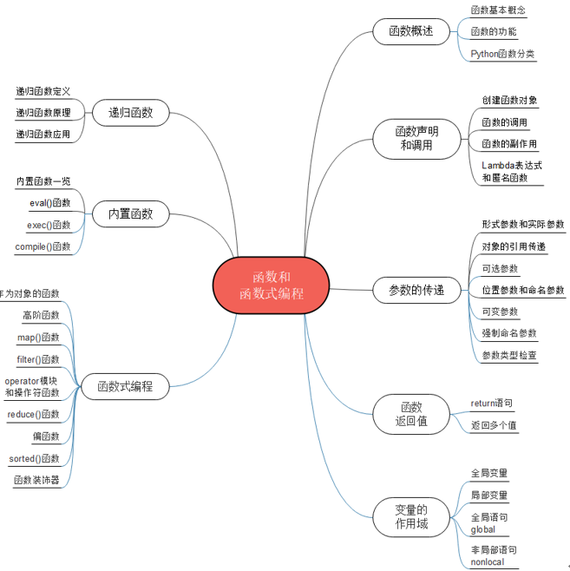
Summary of the chapter

Slide 65
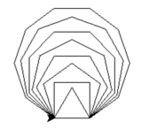
Integrated application: turtle module to draw complex shapes
[Example 4.32] Using Turtle Drawing to draw polygons such as triangles, squares, square pentagons, ......, and square decagons (polygon.py)
import turtle #Import the turtle module
def draw_polygon(sides, side_len): #Draw a square polygon with the specified side lengths.
for i in range(sides):
turtle.forward(side_len) #plot side length (turtle step length)
turtle.left(360.0/sides) #rotation angle
def main().
for i in range(3,11): #Draw square triangles, squares, pentagons, ......, decagons
step = 50 # the side length (turtle step) is 50
draw_polygon(i, step) #draw polygon
if __name__ == '__main__': main() # If standalone runtime, run test code

Slide 66
Recursive Graphics
The concept of Fractal was introduced by the French mathematician Mandelbrot in 1975 to describe shapes where the part is similar to the whole. Fractals can be realized using a simple recursive drawing scheme
[Example 8.57] Drawing the Koch curve (koch.py)
The steps of the recursive plotting algorithm for the nth order Koch curve are as follows:
(1) Termination condition (when n equals 0): draw a straight line.
(2) Recursive steps (when n1): plot a Koch curve of order n-1; rotate 60 degrees to the left to plot a second Koch curve of order n-1; rotate 120 degrees to the right to plot a third Koch curve of order n-1; rotate 60 degrees to the left to plot a fourth Koch curve of order n-1.
The length of the plotted line of the n-1st order Koch curve is 1/3 of the length of the nth order Koch curve

Slide 67

[Example 8.57] Plotting the Koch curve (koch.py)
import sys #Import the sys module
import turtle #Import the turtle module
def koch(t, order, size).
if order == 0: # When n is equal to 0, draw a straight line
t.forward(size)
else: #Otherwise, recursively plot the nth order Koch curve
koch(t, order-1, size/3) #recursively draw a Koch curve of order n-1, length 1/3
t.left(60.0) # rotate 60 degrees to the left
koch(t, order-1, size/3) #recursively draw a Koch curve of order n-1, length 1/3
t.right(120.0) #t.left(-120.0) # rotate 120 degrees to the right (or -120 degrees to the left)
koch(t, order-1, size/3) #recursively draw a Koch curve of order n-1, length 1/3
t.left(60.0) # rotate 60 degrees to the left
koch(t, order-1, size/3) #recursively draw a Koch curve of order n-1, length 1/3
def main().
n = int(sys.argv[1]) #nth order Koch curve
step = 300 #step length
p = turtle.Turtle() #create turtle object
koch(p, n, step) #plot the nth order Koch curve
if __name__ == '__main__': main()

Slide 68
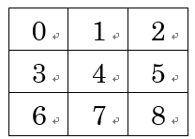
Case Study: Tic Tac Toe Game
The case study in this chapter helps readers gain insight into the use of data structures and algorithms to implement gaming AI through the case study of Tic Tac Toe.
"Tic-Tac-Toe includes more complex computer artificial intelligence (AI) algorithms for placing moves, determining winners and losers, etc. The complexity of the program can be reduced by defining the different functions as independent functions.
Tic Tac Toe, also known as Three Checks and Three in a Row, is a casual puzzle game. The specific gameplay is on a 3*3 board, a player with X as a piece, another player with O as a piece, who first draws three pieces in a row, column or diagonal on the board, you can win, if the board is full and no one wins, it is a draw!
The solution and source code etc. of the case studies are provided in electronic format, please scan the QR code in the tutorial for details

Slide 69
Tic Tac Toe Game Design Ideas
The board is represented by a list of 9 elements, and board[0] to board[8] store strings representing the pieces, which can contain "X", "O", or the numbers 0 to 8 (for unplayed pieces). The flow of the program is as follows:
(1) Initialize the board;
(2) The player is asked to choose a piece: piece X goes first, piece O goes second;
(3) Display the board and drop layout (call function display_board());
(4) Cyclic turn drop:
(4-1) If the player falls, ask the fall position (call function getPlayerMove()), then judge whether the player wins (call function isWinner()), if win, display the board (call function display_board()), output the information, break to jump out of the loop;
(4-2) If the computer artificial intelligence (AI) falls, it calculates the fall position according to the computer artificial intelligence (AI) fall algorithm, and then determines whether the AI wins (call the function isWinner()), and if the AI wins, it displays the board (call the function display_board()), outputs the information, and break jumps out of the loop;
(4-3) Determine whether it is a tie (call function isTie()), if it is a tie, display the board (call function display_board()), output the information, break to jump out of the loop; otherwise, continue to take turns to drop.

Slide 70
Tic Tac Toe Game Design Ideas
The computerized artificial intelligence (AI) drop algorithm is as follows:
(1) If a position can be won by a drop, that position is chosen;
(2) Otherwise, a position is chosen if the player in that position can win by landing next;
(3) Otherwise, choose the empty position in the order of center (4), corner (0, 2, 6, 8), and side (1, 3, 5, 7).
The rules for determining winners and losers are as follows: If three horizontal lines ((0,1,2), (3,4,5), (6,7,8)), three vertical lines ((0,3,6), (1,4,7), (2,5,8)), and two diagonal lines ((0,4,8), (2,4,6)) in a total of eight cases of three squares are equal, then the side of the player wins the game. If all squares fall, it is a draw

Slide 71
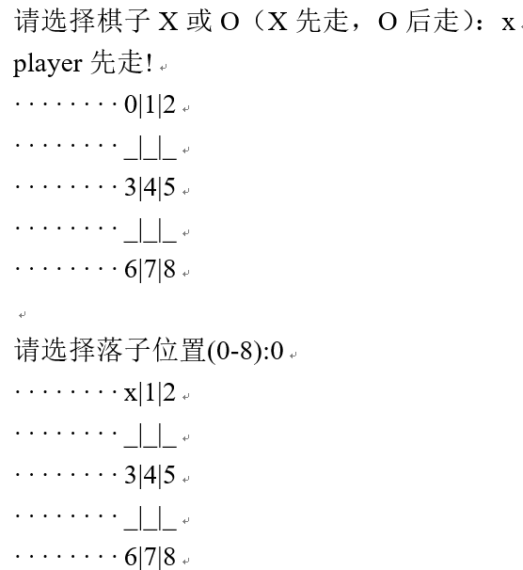
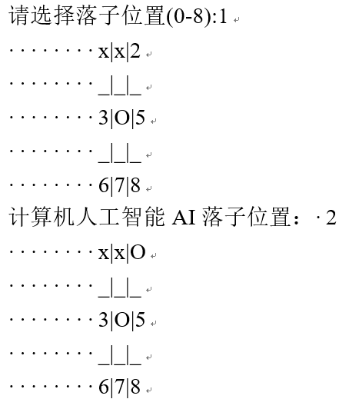
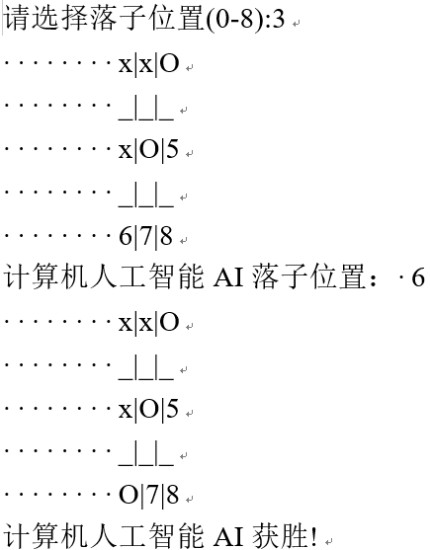
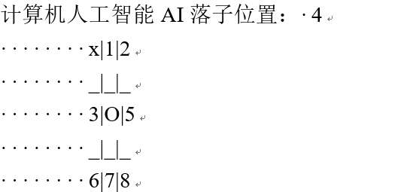
Example of program results

Slide 72
Thank!

